Slide 1

OpenShift Network
OVN-Kubernetes
The new default CNI of OpenShift
OKD-OpenShift

Slide 2

Agenda
Kubernetes & OpenShift Networking - At a Glance
What is OVN (Open Virtual Networking)-Kubernetes?
Why did we move to using OVN-Kubernetes
  Differences between OVN-Kubernetes and OpenShift-SDN (Software
Deﬁned Networking)
How are Kubernetes Networking constructs implemented in OVN-Kubernetes?
OVN-K main components
Pods and Services will be the focus

Slide 3
Kubernetes Networking

Slide 4
Kubernetes Networking
- Where does OVN-Kubernetes belong in the Kubernetes world?
Kubernetes Fundamental Networking requirements
  Every pod must have its own unique IP
  Pod to pod communication must be possible within the cluster
  Node to pod communication must be seamless
Kubernetes Networking Model
  K8s is a bunch of APIs, it is plugin agnostic as far as networking is concerned
  Networking solutions are implemented on top of core K8s using Container Network Interface (CNI) Speciﬁcation
  OVN-Kubernetes is one such CNI (others include ﬂannel, antrea, cilium, calico etc)
Kubernetes
CNI
Pod
eth0
4

Slide 5
OpenShift Networking
OVN-Kubernetes became default CNI of OCP from 4.12 release

Slide 6
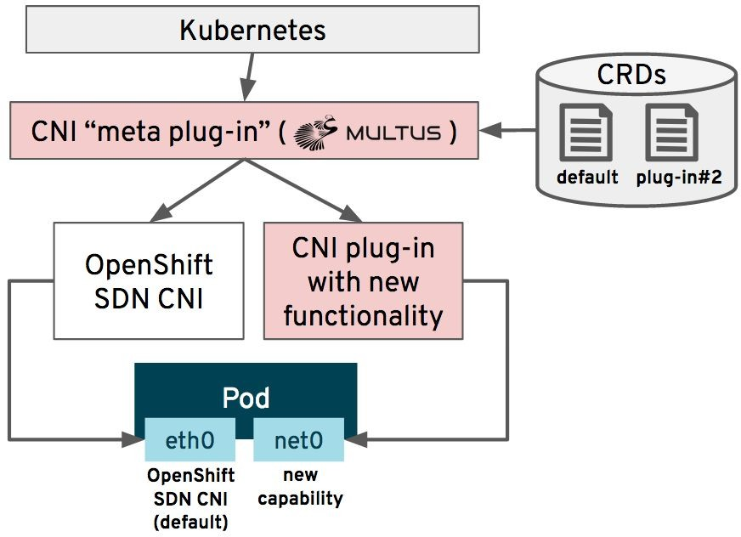
OpenShift Networking
OpenShift implements it’s networking fabric using the Cluster Network Operator (CNO)
CNO Supports 2 network types:
  OpenShift SDN - legacy default plugin
  OVN-Kubernetes - current default plugin since 4.12 OCP
Multus is a meta CNI plugin that allows pods to have multiple interfaces by interfacing with more than one type of CNI plugin

Slide 7
OpenShift Networking
- Where does OVN-Kubernetes belong in the OpenShift world?
OPENSHIFT
KUBERNETES CNI
Tigera Calico Core | Cisco ACI | VMware NCP | Isovalent Cilium Community | VMware Antrea | Juniper CN2 | kuryr-kubernetes 2
OVNK
OpenShift SDN
DEFAULT
Interoperability Support Matrix
Version 2023-05-17

Slide 8
OVN-Kubernetes - What?

Slide 9
OpenShift-SDN: Legacy Network Provider
- What is OpenShift - Software Deﬁned Networking?
Kubernetes API
OpenShift SDN
Manages Pod networking
Manages OVS
Manages network flows and policies
Enables cross-node Pod networking
OVS (Open vSwitch)
Actually switches and forwards packets
kube-proxy
Implements Kubernetes Service → Pod forwarding
Linux Kernel
Provides the underlying networking machinery
OpenShift SDN
OVS
kube-proxy
Kernel Networking Stack

Slide 10
Kubernetes / OpenShift
│
┌──────────┴──────────┐
│ │
kube-proxy OpenShift SDN
│ │
Service handling Pod networking
│ │
iptables OVS
│ │
└──────────┬──────────┘
│
Linux kernel networking
│
NIC / physical network

Slide 11
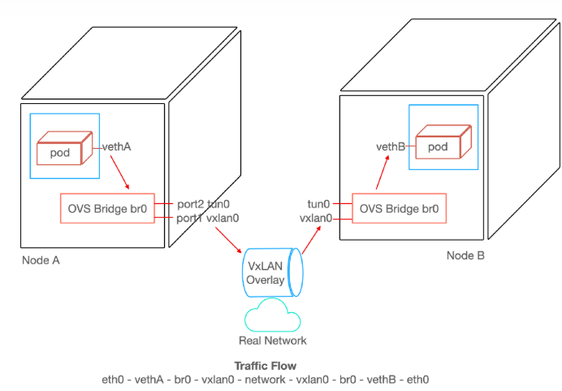
OpenShift SDN

Slide 12
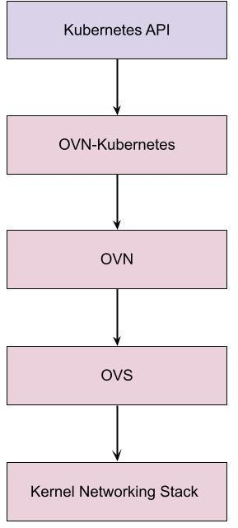
OVN-Kubernetes
- Open Virtual Networking for Kubernetes / OVN-K8s
Open Source project that provides a robust networking solution for Kubernetes clusters
Has OVN - Open Virtual Networking and OVS - Open Virtual Switch at its core
  Uses them as the abstraction layers to manage cluster networking trafﬁc ﬂows on the node
Uses GENEVE (Generic Network Virtualization Encapsulation) protocol between nodes to provide overlay networking.
Creates logical network topology per node and connects them together
  logical routers, switches, pod ports

Slide 13
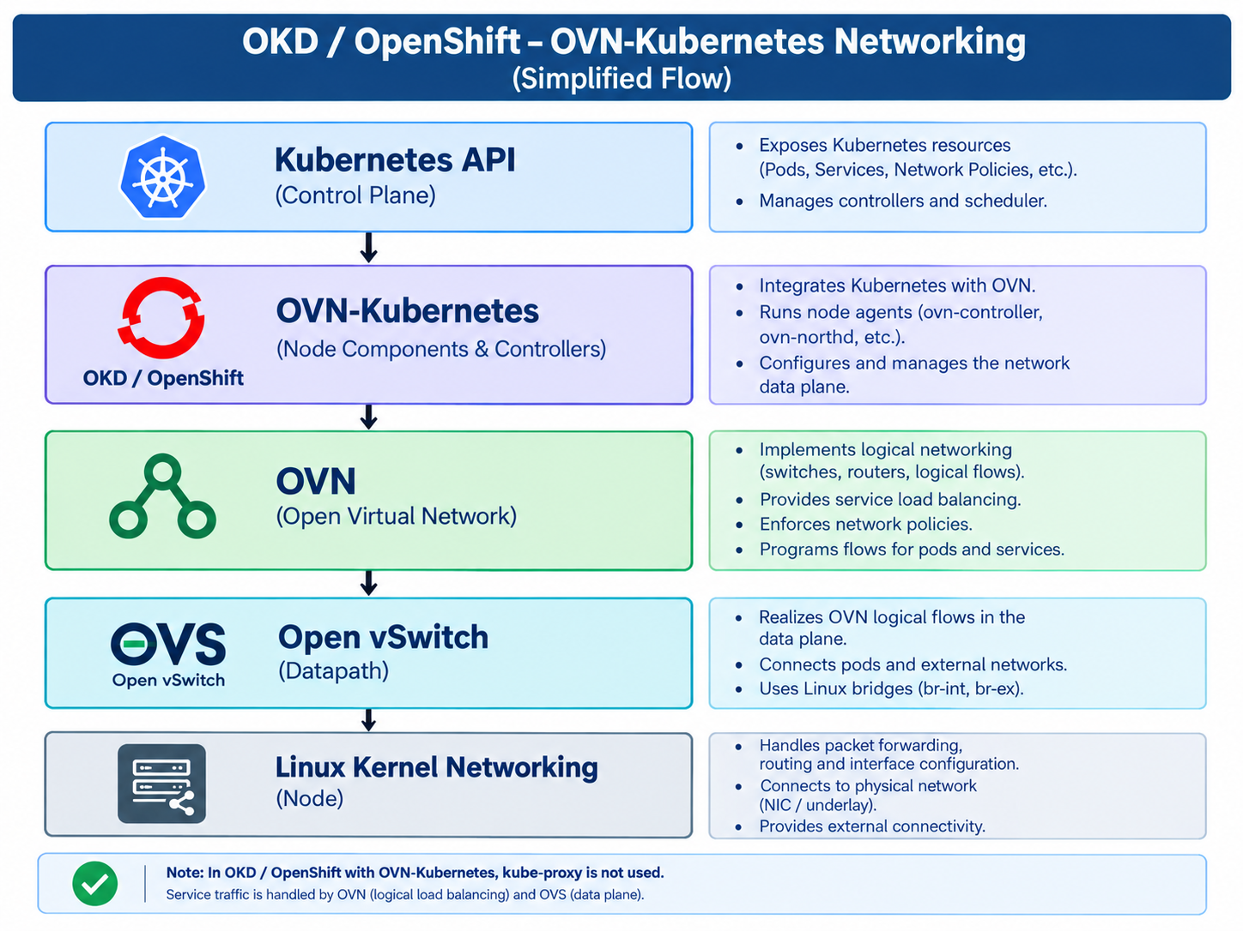
OVN-Kubernetes

Slide 14
Technology Highlights Comparison
Wait a Minute…! Does that look too familiar? If so, what changed and why did we move?
Legacy OpenShift SDN Plugin | OVN-Kubernetes
Creates veth pairs | Creates veth pairs
Creates an OVS switch | Creates an OVS switch
Central IPAM controller | Central IPAM controller
OVS ﬂows for Network Policies | OVS ﬂows for Network Policies
VXLAN tunnels between nodes | GENEVE tunnels between nodes
IPTable Rules for Services | OVN constructs for Services
IPTable Rules for NATing | OVN constructs for NATing
veth - Virtual Ethernet
IPAM - Internet Protocol Address Manager (here in context of allocating podIPs)

Slide 15
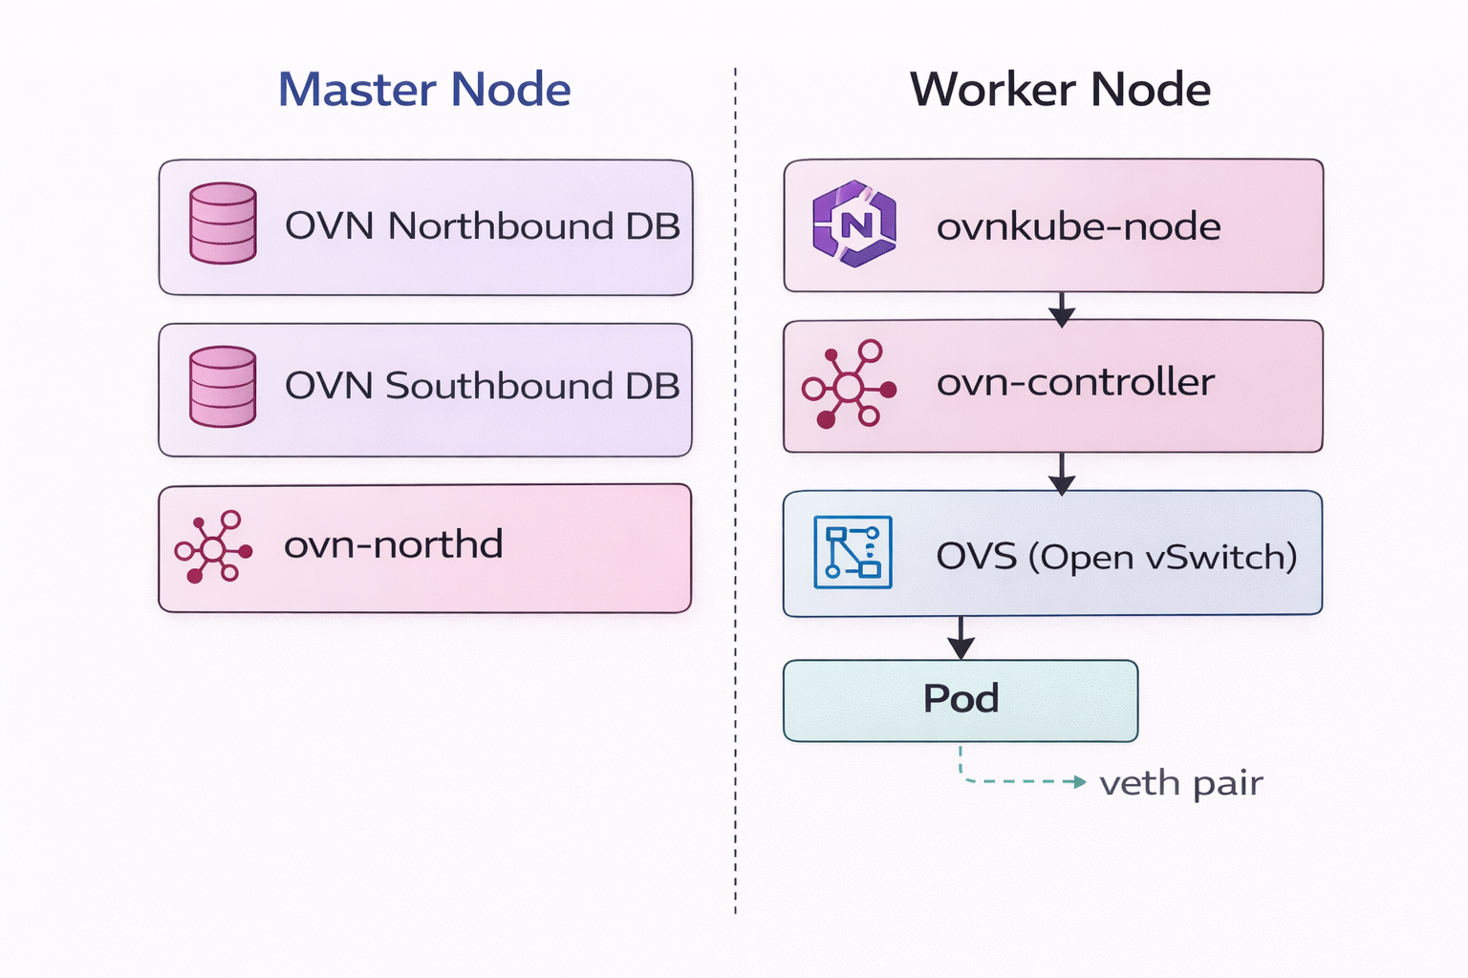

Slide 16
Northbound DB (OVN NB DB)
Stores the desired network state.
Examples:
Pod network configuration
Services
Network policies
Logical switches
Logical routers
When Kubernetes creates a Pod or NetworkPolicy, OVN-Kubernetes writes the desired networking configuration into the Northbound DB.
ovn-northd
A daemon that acts as a translator.
It:
Reads desired network state from the Northbound DB.
Generates low-level logical networking rules.
Writes those rules into the Southbound DB.
It does not configure nodes directly.

Slide 17
Southbound DB (OVN SB DB)
Stores the network instructions that nodes need to implement.
Contains:
Logical flows
Port bindings
Tunnel information
Node (chassis) information
Worker nodes consume information from the Southbound DB.
ovn-controller
Runs on every worker node.
It:
Reads instructions from the Southbound DB.
Programs Open vSwitch (OVS) on that node.
Keeps the node networking synchronized with OVN.

Slide 18
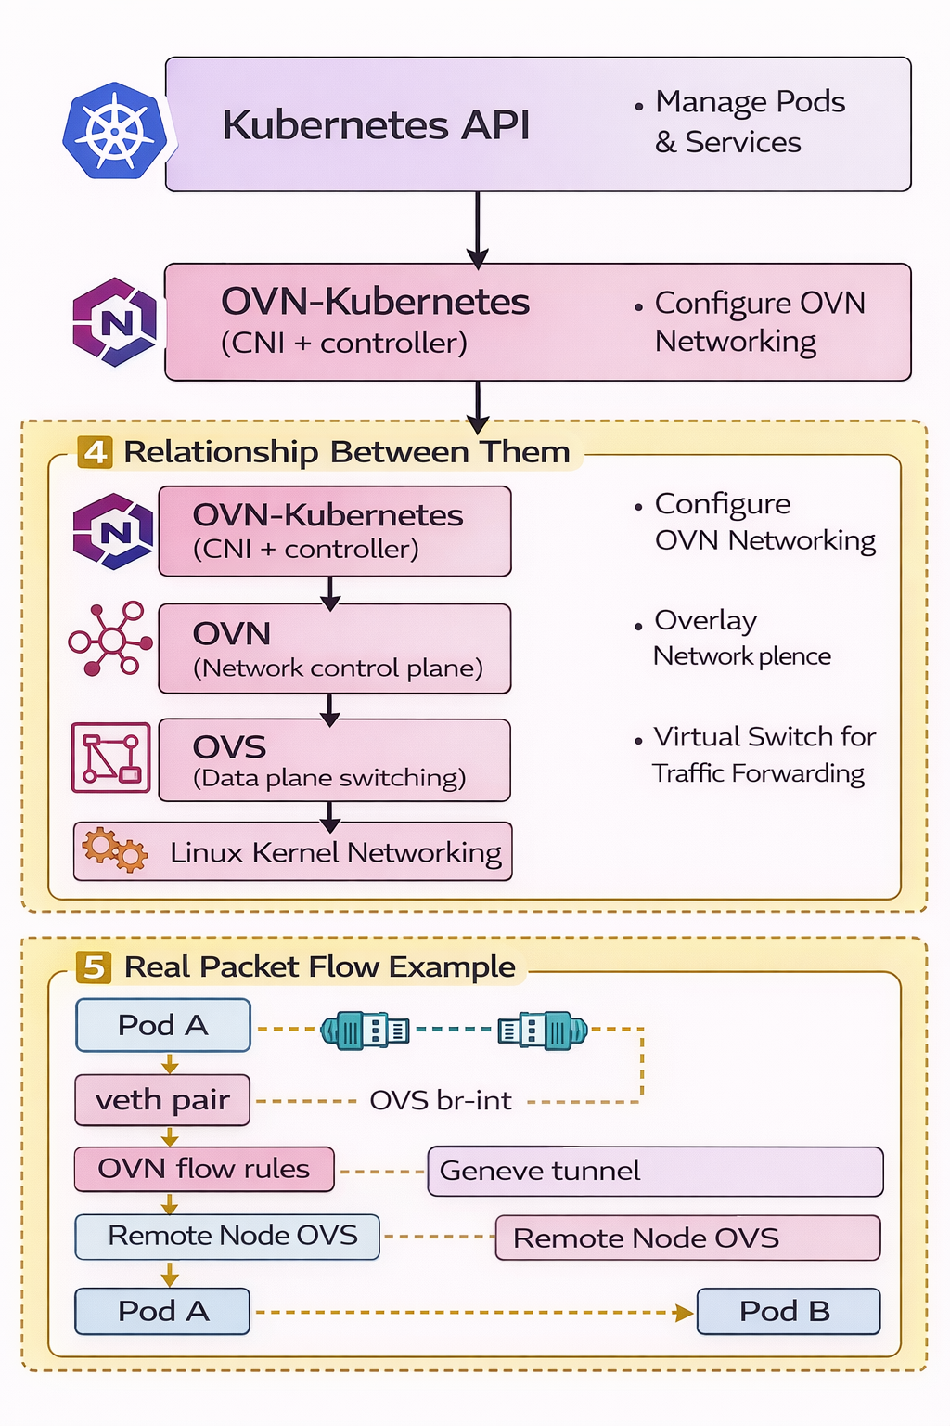
Networking Stack Relationship
Kubernetes API
Stores cluster state (pods, nodes, services)
Networking plugins watch this
OVN-Kubernetes Network Plugin
Creates networking for pods
Talks to OVN to configure networking
Kubernetes → tells → OVN-Kubernetes → configures → OVN
Kubernetes
OVN-Kubernetes (CNI Plugin)
OVN (Network Control Plane)
Open vSwitch (Data Plane)
Linux Kernel Networking

Slide 19
Route
TLS termination Edge, PassThrough, re-encrypt

Slide 20
03 Create and Edit External Routes
Route Types
Example: Create a Simple Route
Simple Route
# Expose a service as a route
HTTP, no TLS, basic hostname mapping
$ oc expose svc/my-app \
--hostname=myapp.apps.example.com
Edge TLS
# Or use YAML:
TLS terminated at router, traffic plain inside
apiVersion: route.openshift.io/v1
kind: Route
metadata:
Passthrough
name: my-app-route
Encrypted end-to-end to pod (no decryption)
spec:
host: myapp.apps.example.com
to:
Re-encrypt
kind: Service
Router decrypts → re-encrypts to pod
name: my-app
port:
targetPort: 8080
# Apply it:
$ oc apply -f route.yaml

Slide 21
05 Secure Traffic Using TLS Certificates
TLS Termination Types
Create TLS Edge Route — Example
Edge
# 1. Generate self-signed cert (for testing)
$ openssl req -x509 -nodes -days 365 \
TLS ends at router. Pod receives plain HTTP. Use: public web apps.
Client --- HTTPS ---> OpenShift Router --- HTTP ---> Pod
-newkey rsa:2048 \
-keyout tls.key -out tls.crt
Passthrough
# 2. Create TLS secret
Router passes encrypted traffic to pod. Pod handles TLS.
Client --- HTTPS ---> Router --- HTTPS ---> Pod
$ oc create secret tls my-tls-secret \
--cert=tls.crt --key=tls.key
# 3. Create edge route with TLS
Re-encrypt
$ oc create route edge my-secure-route \
--service=my-app \
Router decrypts, then re-encrypts with its own cert to pod.
Client --- HTTPS ---> Router --- HTTPS (new TLS) ---> Pod
--cert=tls.crt --key=tls.key \
--hostname=secure.apps.example.com
# 4. Verify route is secure
$ oc get route my-secure-route

Slide 22
# List router pods
oc get pods -n openshift-ingress
oc get svc router-default -n openshift-ingress

Slide 23




OpenShift Route — Traffic Flow Diagram
www.mango.com
DNS lookup
OpenShift Cluster
💻
1
🌐
2
🔀
3
📋
⚙️
Host:
4
CNAME
routing
Client
DNS
OCP Router
header match
Route
Service
Browser
CNAME record
resolves →
HAProxy
rule →
www.mango.com
mango ClusterIP
www.mango.com
5
Domain Based Traffic Routing
# oc create ingress myapp --rule www.mango.com/*=myapp:80
🟦
🟦
Pod
Pod
replica 1
replica 2
🖥️ CRC (Local Dev — Windows)
📄 Route YAML
⚡ Route vs Nginx Ingress
Add to hosts file:
kind: Route
host: www.mango.com
to.name: mango
port: 80
tls: edge
Route: HAProxy built-in, zero install
CNAME → router hostname
Nginx: separate controller
A Record → LB IP (simpler DNS)
C:\Windows\System32\drivers\etc\hosts
127.0.0.1 www.mango.com
Then: ipconfig /flushdns
ROSA/ARO: Use CNAME record → router-default.apps.<cluster>.openshiftapps.com

Slide 24
DNS Setup Comparison
OpenShift Route — CNAME
Nginx Ingress — A Record ✅
mango.com
↓ CNAME
apps.cluster-xyz.openshiftapps.com
↓ Router reads Host: header
→ mango Service
apple.com
↓ CNAME
apps.cluster-xyz.openshiftapps.com
↓ Router reads Host: header
→ apple Service
mango.com
↓ A Record
203.0.113.10 (LB IP — stable)
↓ Nginx reads Host: header
→ mango Service
apple.com
↓ A Record
203.0.113.10 (same LB IP)
↓ Nginx reads Host: header
→ apple Service
VS

Slide 25
YAML Configuration Side-by-Side
OpenShift Route (×2 files needed)
Nginx Ingress (single file ✅)
# mango-route.yaml
kind: Route
metadata:
name: mango-route
spec:
host: mango.com
to:
kind: Service
name: mango
port:
targetPort: 8080
tls:
termination: edge
---
# apple-route.yaml (separate file)
kind: Route
metadata:
name: apple-route
spec:
host: apple.com
to:
kind: Service
name: apple
port:
targetPort: 8080
tls:
termination: edge
# apps-ingress.yaml (ONE file!)
apiVersion: networking.k8s.io/v1
kind: Ingress
metadata:
name: apps-ingress
annotations:
nginx.ingress.kubernetes.io/
ssl-redirect: "true"
spec:
ingressClassName: nginx
rules:
- host: mango.com
http:
paths:
- path: /
pathType: Prefix
backend:
service:
name: mango
port:
number: 8080
- host: apple.com
http:
paths:
- path: /
pathType: Prefix
backend:
service:
name: apple
port:
number: 8080
VS

Slide 26
Thank You Q&A?

